Slide 1

UNIT -2
ENVIRONMENT AND SOCIETY

Slide 2

What is Environment?

Slide 3

What do you mean by society?

Slide 4
Definition of environment
Environment is the sum total of all conditions and influences the that affect the life and development of organisms

Slide 5
How does man influence environment?

Slide 6
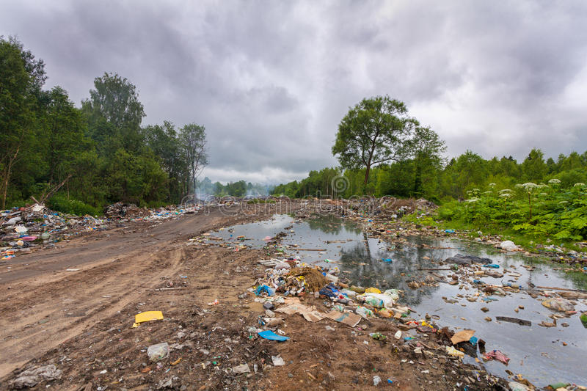
What is environment pollution
Environment pollution is defined as the contamination of the physical and biological components of atmosphere system to such an extent that normal environment will be affected .

Slide 7
Some of the problems of environment pollution
Global warming,
Depletion of ozone layer ,
Extinction of biodiversity.

Slide 8
Environmental crisis
Is a catastrophic situation in which the normal pattern of life or ecosystem has been disrupted which needs timely interventions to save or preserve environment.
some of them are global warming ,green house effect, climate change, acid rain, ozone depletion etc.

Slide 9
Reasons for threat to environment
1. The need to meet the increasing energy requirement.
2. Impact of industrialization.
3. Expanding urbanization.
4. Huge quantity of solid waste.
5. Increasing requirements of huge population.

Slide 10
Save the environment
List the ways by which you can contribute to save the environment .

Slide 11
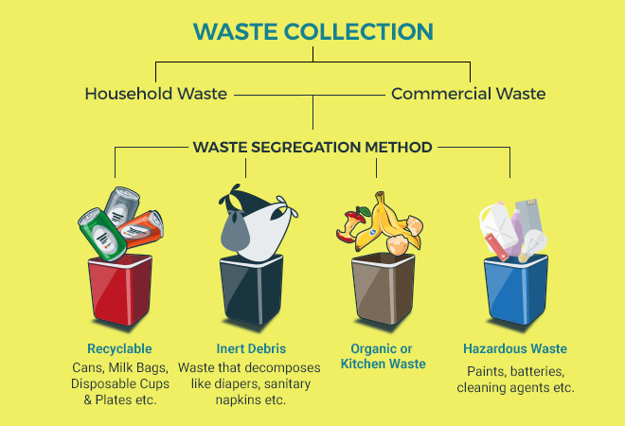
Thumb rule for segregation of waste
WASTE MANAGEMENT

Slide 12
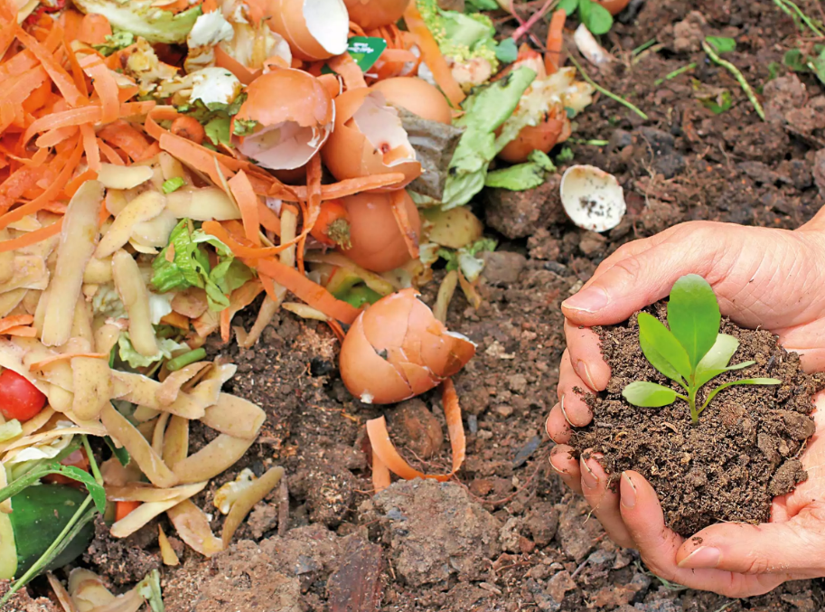
SOLID WASTE MANAGEMENT
Solid waste is an alternate term for garbage management.
The broad categories of garbage are:
Organic waste
Toxic waste
Recyclable waste
Hospital waste

Slide 13
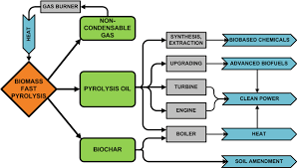
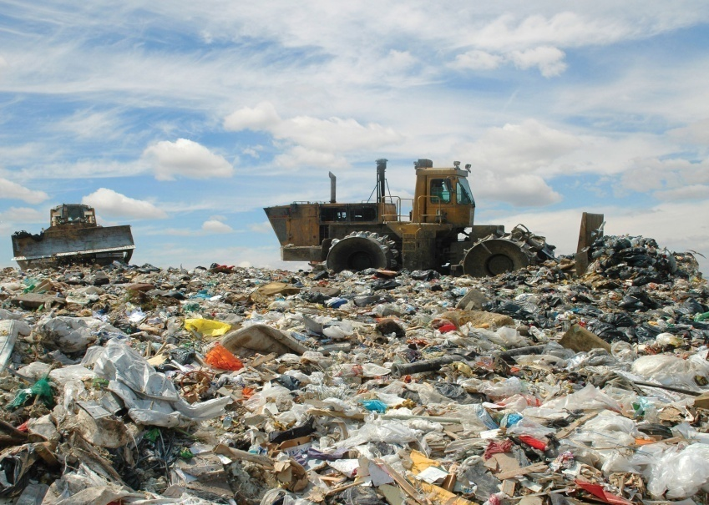
Methods of solid wastes disposal
1. Sanitary land fill
2. Incineration
3. Composting –Vermi-composting , benefits and limitation of composting .
4. Pyrolysis

Slide 14
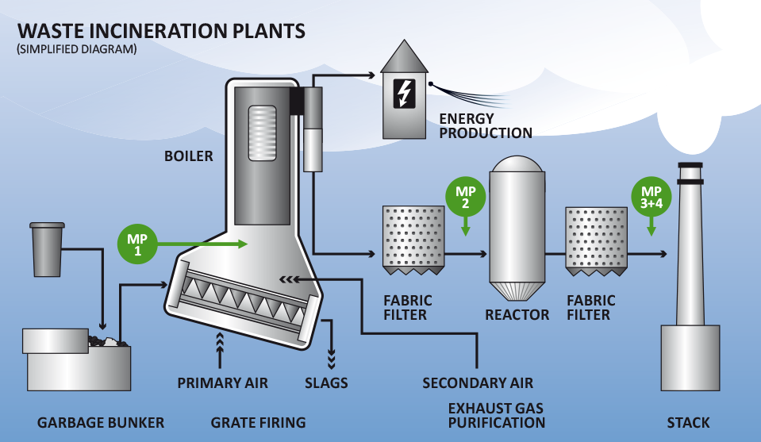

Slide 15
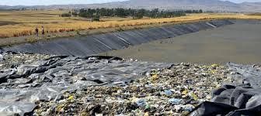
Liquid waste management
Difference between sewage and silage .
The treatment to sewage focused on three things
Removal of suspended matters.
Reduction of the organic matter .
Production of germ free water.

Slide 16
Three stages of treatment of sewage water.
primary or physical treatment
secondary or biological treatment
tertiary or chemical treatment

Slide 17
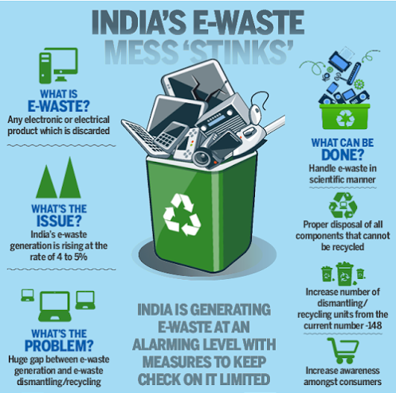
E-WASTE MANAGEMENT
responsibilities of the government.
responsibility and role of industries.
responsibilities of the citizen

Slide 18
Zero waste management
Zero waste is a goal that is ethical , economical, efficient and visionary, to guide people in changing their life styles and practices to emulate sustainable natural cycles, where all discarded materials are designed to become resources for others to use.

Slide 19
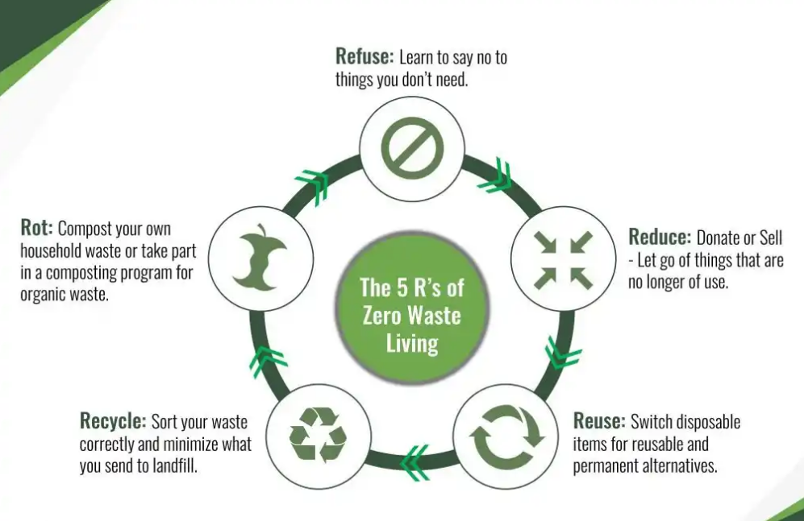

Slide 20
5R’s of zero waste management
Refuse
Reduce
Reuse/repair
Recycle
Rot

Slide 21
Thank you

